Slide 1
Disease, Diagnosis, And Treatment
Section IV:

Slide 2
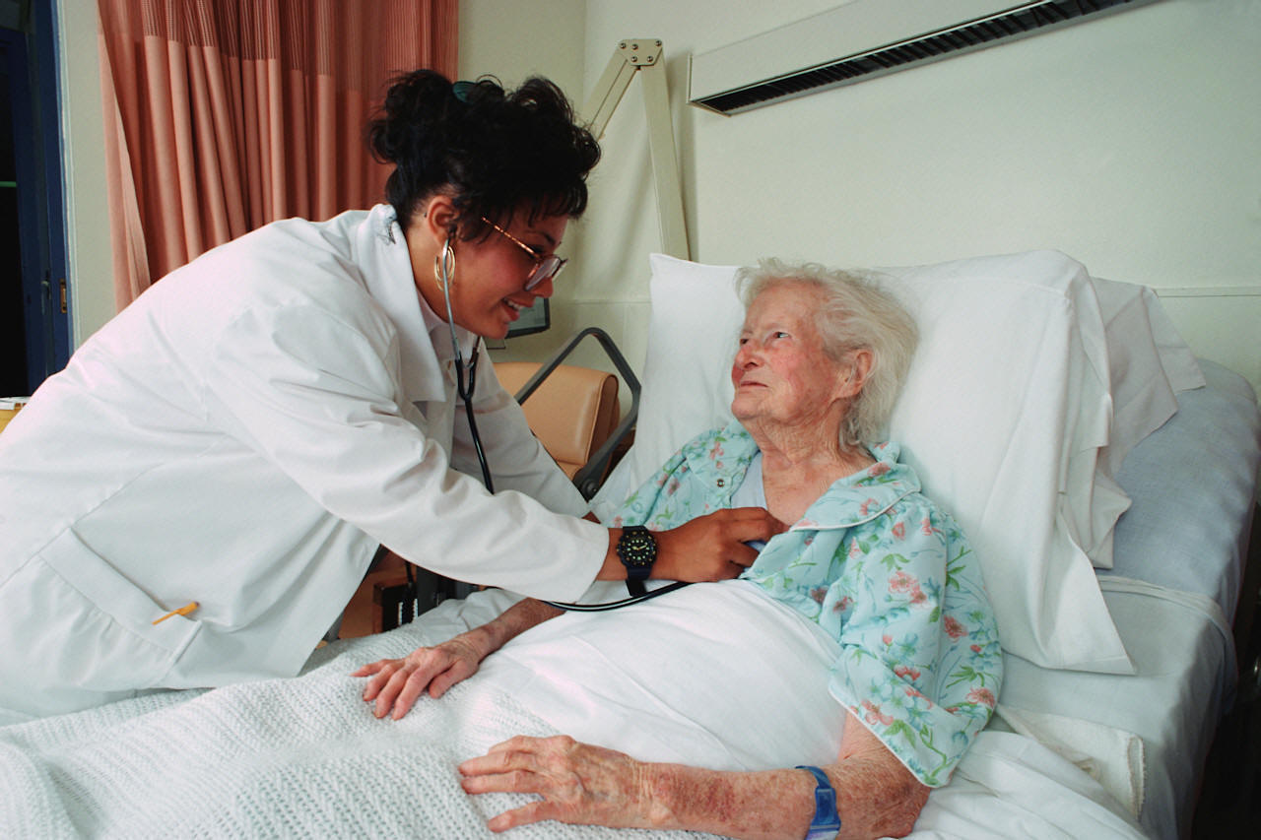
Disease
Definition:
Any alteration from the normal structure or function
Acute: sudden, severe, short duration
Chronic: long lasting, progresses slowly
Cause: etiology
General Terms:
Systemic: the whole body
Idiopathic – no known cause
Opportunistic: infection in compromised host
Exacerbation: worsening or reoccurrence
Remission: lessoning of symptoms
Nosocomial: acquired in a hospital
Iatrogenic: following treatment
In Situ: localized, non-invasive
Septicemia: pathogen in blood, blood poisoning

Slide 3
Disease Categories
Infectious diseases – caused by microorganisms and other parasites. Called pathogens.
Degenerative diseases – caused by wear and tear, aging, or trauma.
Neoplasia – caused by abnormal and uncontrolled growth of tissue.
Immune disorders – caused by failures of the immune system, allergies, and autoimmune disorders.
Metabolic disorders – caused by lack of enzymes needed for cellular function. Malnutrition.
Hormonal disorders – caused by overproduction or underproduction of hormones.
Mental and emotional disorders – disorders that affect the mind and behavior of an individual
Notes:
inactive state.

Slide 4
Naming Diseases
Place where discovered – Lyme, West Nile, Rift Valley fever (Africa), Hantavirus (River in Korea)
Person who discovered – Cooley’s anemia, Crohn’s disease, Hodgkin’s disease, Parkinson’s
Symptoms –Tubercles in lungs, black skin lesions – anthrax (anthracite coal), sickle cell anemia (sickle-shaped red blood cells)
Causative agent – candidiasis, salmonellosis
Color – Yellow fever, Scarlet fever
Notes:
– shaped like sickles

Slide 5
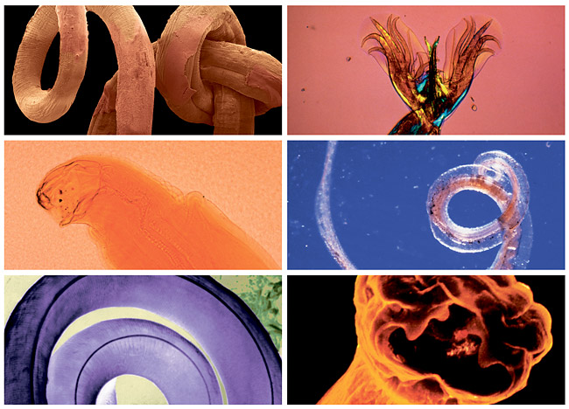
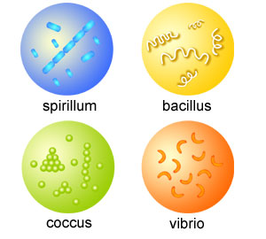
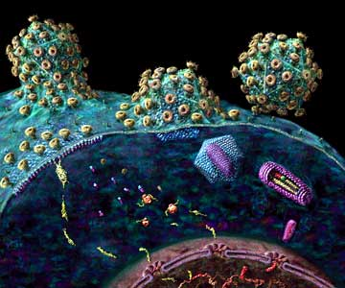
Infectious Diseases
Bacteria – microscopic organisms
Cocci - pneumonia, rheumatic fever, food poisoning, gonorrhea
Bacilli - typhoid, dysentery, tuberculosis, tetanus, salmonellosis
Vibrios – cholera, gastroenteritis
Spirochetes – Lyme disease, syphylis
Chlamydia – STD’s, conjunctivitis
Rickettsia – Rocky Mountain Spotted fever, typhus
Protozoa – single-celled organisms
Dysentery, malaria, trichomonas
Helminthes – worms
Roundworms, pinworms, hookworms, tape worms, trichinosis infestations
Fungi
Ringworm, valley fever, nail infections, athletes foot, endocarditis
Viruses – submicroscopic agents
Colds, flu, herpes, hepatitis, HIV/AIDS, chickenpox (varicella), shingles, measles, rabies, smallpox, Ebola

Slide 6
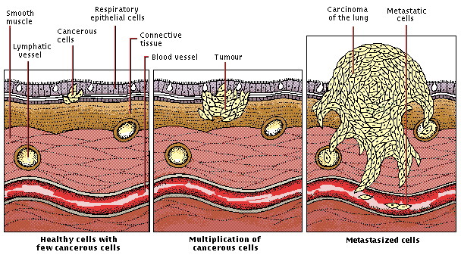
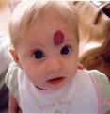
Neoplasia
Benign tumors:
Slow growing
Encapsulated
Non-invasive
Well-differentiated
Non-metastatic
Malignant tumors:
Fast growing
Invasive
Undifferentiated
No well-defined borders
Metastatic

Slide 7
Naming and Staging of Neoplasms
Benign tumors:
Root + suffix –oma
Lipoma = benign tumor of adipose tissue
Malignant tumors:
Root + suffix -carcinoma or
Root + suffix –sarcoma
Liposarcoma = cancer of adipose tissue
Exceptions:
Leukemias
Lymphomas
Wilm’s tumor – pediatric kidney tumor
TNM staging:
T: 0-4 (tumor size)
N: 0-3 (number of lymph nodes involved)
M: 0-3 (distant metastases present or absent)
Classified as:
Stages Ia, Ib, IIa, Iib, III, IV
T1N0M0 = stage I
Survival rate high

Slide 8
Mental and emotional disorders
Neurodevelopmental disorders
Autism spectrum disorder, ADHD, Tourette’s
Schizophrenia spectrum/ psychotic disorders
Bipolar and related disorders
Depressive disorders
Anxiety disorders
separation anxiety, phobias, social anxiety disorder
Obsessive-compulsive and related disorders
Trauma- and stressor-related disorders
posttraumatic stress disorder, acute stress
Dissociative disorders
Somatic symptom disorders
illness anxiety, conversion disorder
Feeding and eating disorders
pica, anorexia nervosa, bulimia
Elimination disorders
Sleep-wake disorders
insomnia, narcolepsy, sleep apnea
Sexual dysfunctions
Gender dysphoria
Disruptive, impulse-control, and conduct disorders
Substance-related and addictive disorders
Neurocognitive disorders

Slide 9
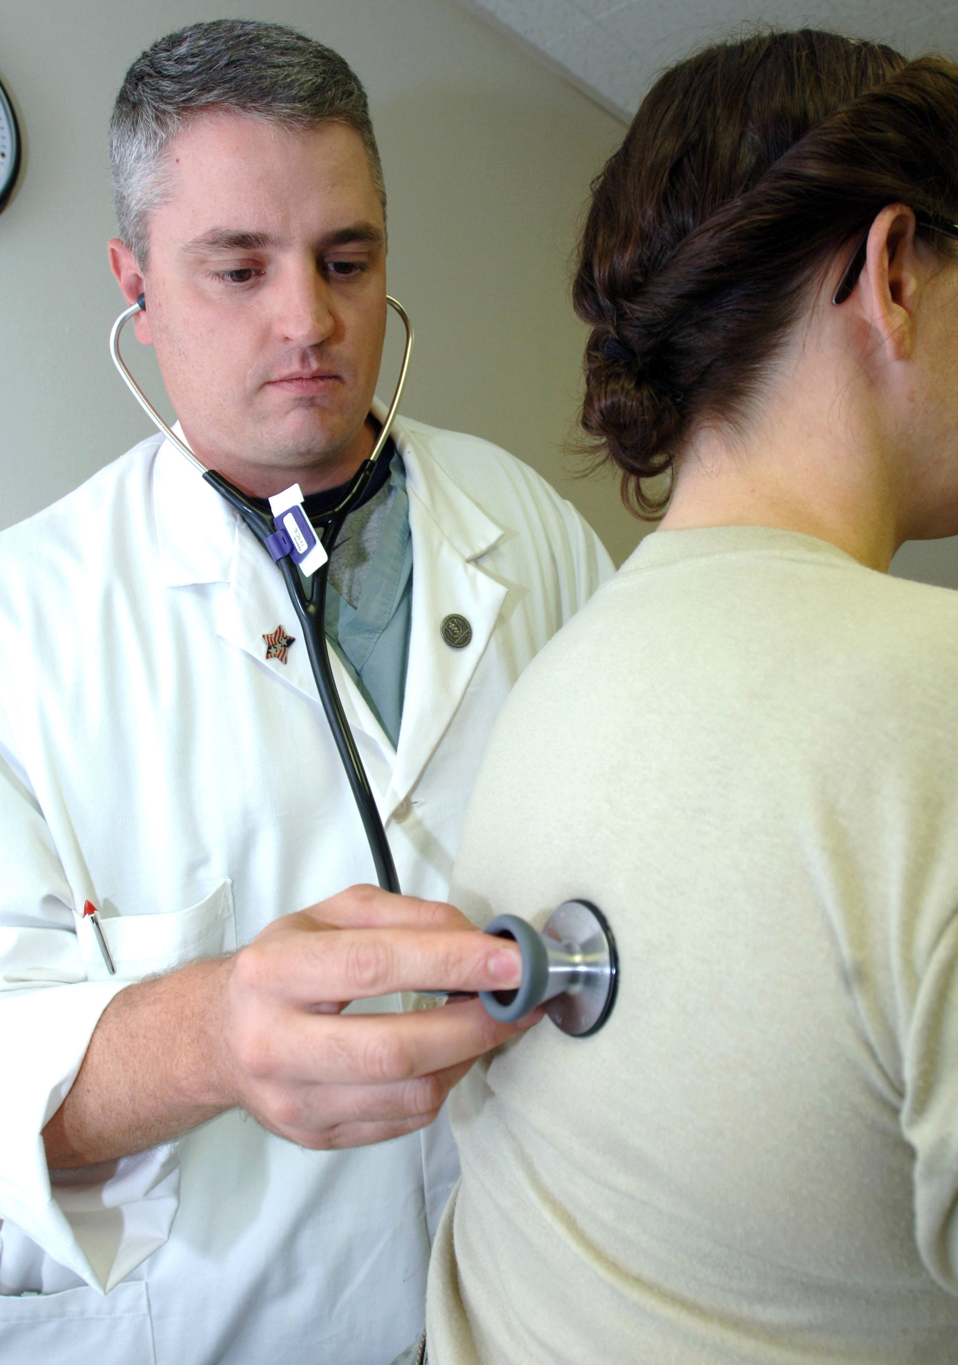
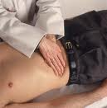
Diagnosis: Determine nature and cause of disease
Start with History and Physical (H & P)
History of present illness (CC), description of symptoms
Past medical history
Family and social history
Physical examination:
Review of systems, Vital Signs
Techniques:
Inspection: visual exam. Check hair, skin, nails
Palpation: touching body with hands or fingers
Percussion: tapping body and listening to sounds produced
Auscultation: listening to body sounds with stethoscope
Tools:
Stethoscope, Otoscope, ophthalmoscope, reflex hammer, thermometer, sphygmomanometer

Slide 10
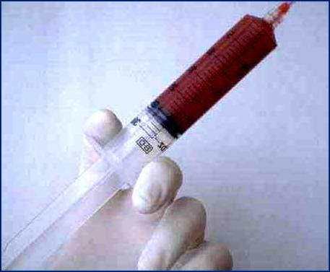
Laboratory Tests
Blood Tests
CBC: complete blood count
Counts types of blood cells
Lipid panel
Measures risk of heart disease
Cholesterol, triglycerides
Liver panel
Measures liver function – 4 tests
Electrolytes
Measures balance of sodium, potassium, chloride, bicarbonate
Basic metabolic panel – 8 tests
Glucose, calcium, BUN, creatinine, CO2, chloride, potassium, sodium
Complete metabolic panel – 14 tests
4 tests for liver function
2 tests for protein
Other Lab Tests
Urinalysis
Microscopic and dipstick
Stool tests
Throat culture
Blood culture
Lumbar puncture
Pregnancy and newborn tests

Slide 11
Imaging
Radiography: X-rays on film
Use barium to show contrast
Cineradiography: motion pictures on a screen
PET (positron emission tomography): inject positron isotope, measures emissions, computer interprets
MRI (magnetic resonance imaging): uses magnetic field and radio waves, eliminates need for x-rays
Ultrasonography: measures high-frequency sound waves from different body tissues
CT (computed tomography) scan: x-rays taken at multiple angles in body to produce cross-sectional view
Additional terms
intravenous pyelogram
angiography
echocardiography

Slide 12
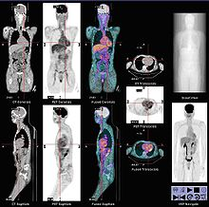
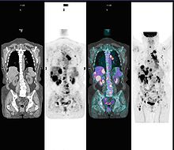
Nuclear Medicine
Radioactive substance given
Orally
Intravenous
Gamma camera forms images from radiation emitted
Sent to computer for analysis
Images specific areas or whole body:
Lung, bone, heart, thyroid, liver, kidneys
Common substances are:
Iodine 123, Thallium, Gallium

Slide 13
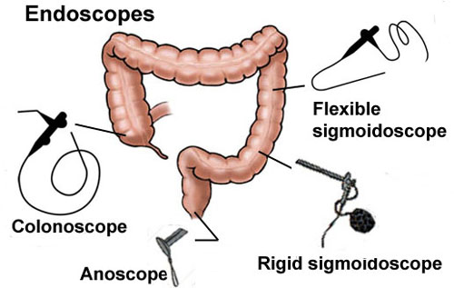
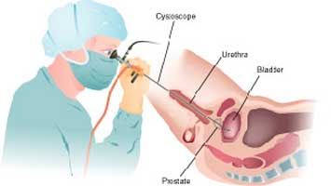
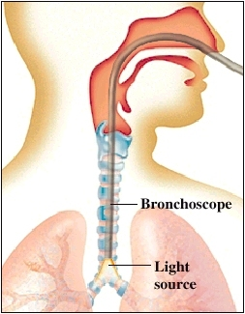
Scopes
Scopes examine body cavities
Cystoscopy
Endoscopy
Bronchoscopy
Laryngoscopy
Arthroscopy

Slide 14
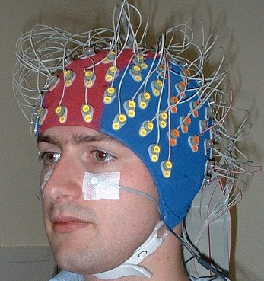
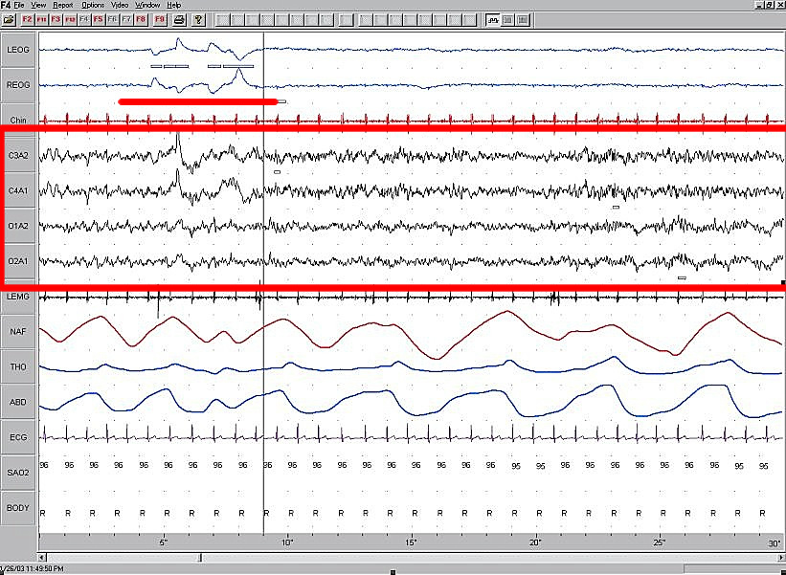
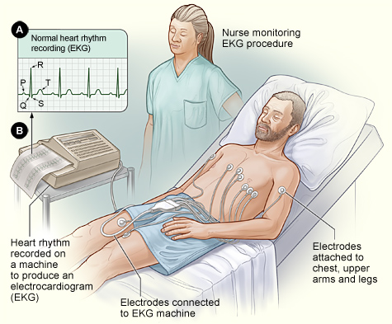
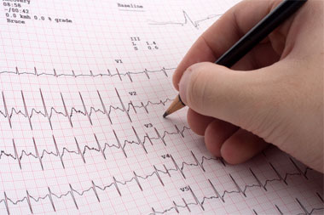
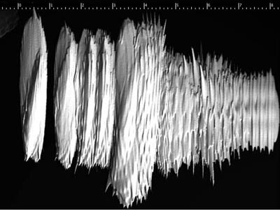
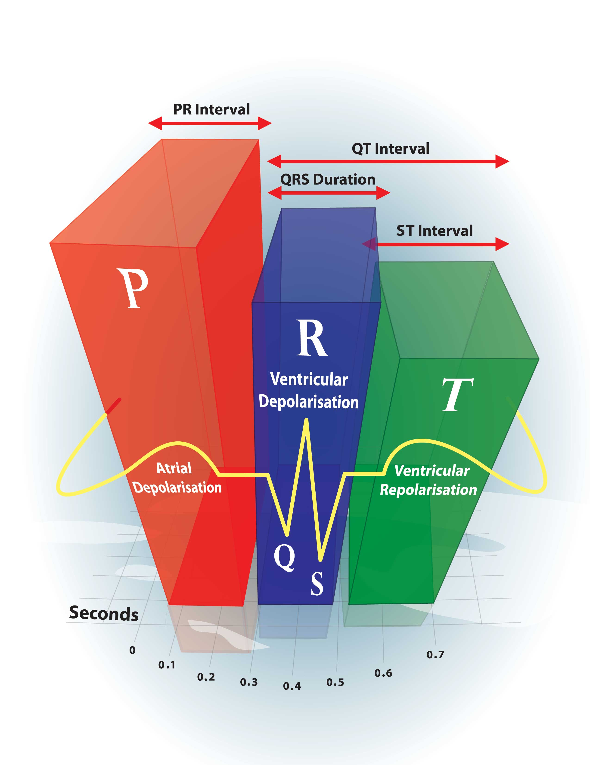
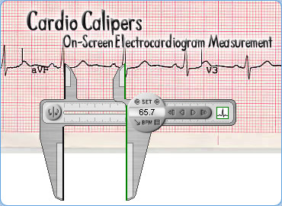
Measure Electrical Activity
Electroencephalography
Electrocardiography

Slide 15
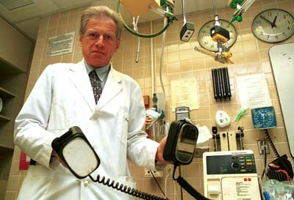

Treatments
Drugs
Surgery
Radiation
Physical therapy
Occupational therapy
Psychiatric treatment
Combined treatment
Alternative or complementary treatment

Slide 16
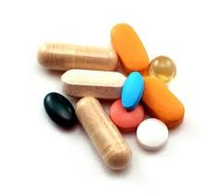
Drug Treatment
Commonly used drugs (6 classes):
Antibiotics
Diuretics
NSAIDS
Beta-blockers
Steroids
Anticoagulants
Routes of administration:
Oral
Sublingual
Inhalation
Parenteral
Transdermal
Rectal
Topical
Vaginal

Slide 17
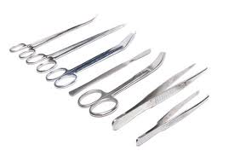
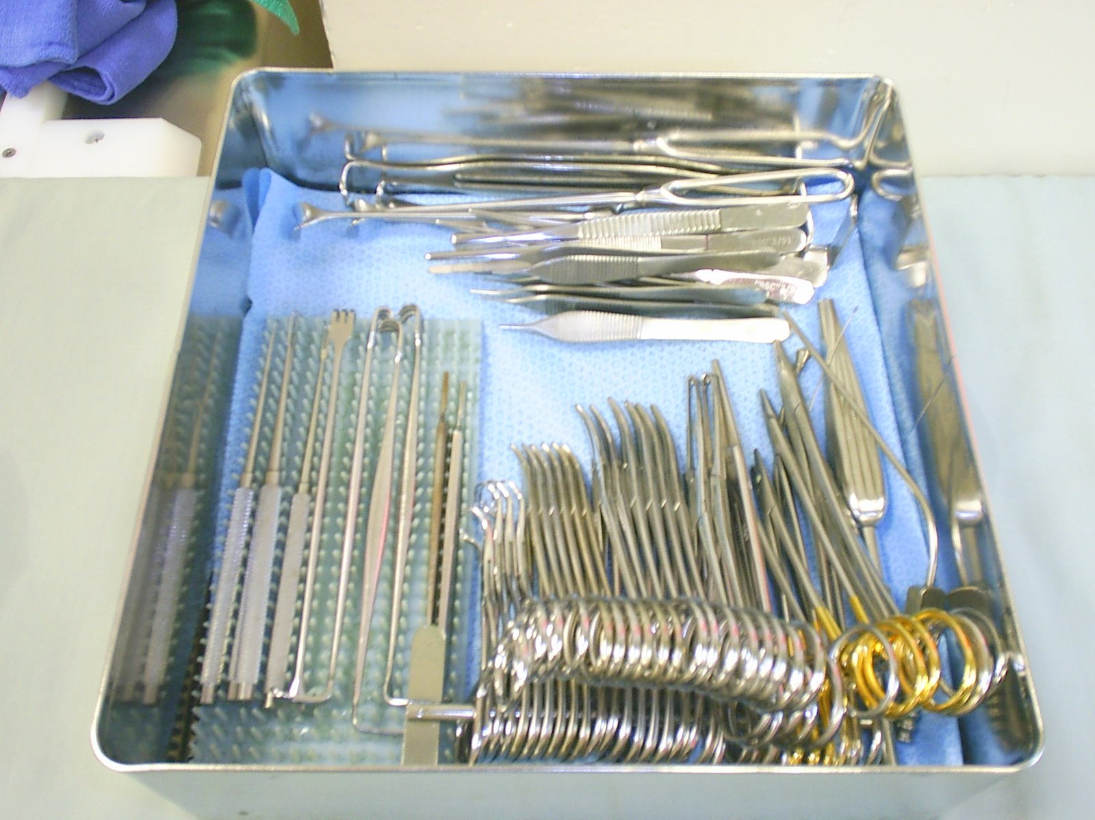
Surgery
Biopsy: removes piece of tumor
Resection: removal of all or part of an organ
Ligation: tie off (tubal ligation)
Surgical instruments:
Suffixes:
-centesis surgical puncture
-ectomy surgical removal
-otomy surgical incision
-plasty to modify or reshape
-tripsy to crush
-opsy to look at, examine
-pexy to fix, secure, or suspend
-desis to fuse or stabilize
Other terms:
thoracentesis
angioplasty
atherectomy
arthrocentesis
trephination
cryosurgery
dermatoplasty
escherotomy

Slide 18
Resources
Textbooks:
Chabner, Davi-Ellen. The Language of Medicine. 10th ed. Saunders, 2013. $72.95
Cohen, Barbara Janson and Ann DePetris. Medical Terminology: an Illustrated Guide. 7th ed. Lippincott, Williams & Wilkins, 2013. $66.95
Gylys, Barbara and Regina Masters. Medical Terminology Simplified Text and Audio CD. 4th ed. F.A. Davis, 2009. $45.95
Online – Dictionaries:
Medline Plus - http://www.nlm.nih.gov/medlineplus/mplusdictionary.html
Medlexicon – http://www.medlexicon/medicaldictionary/php
Free Dictionary – Medical-dictionary – http://medical-dictionary.thefreedictionary.com/
MedicineNet - http://www.medterms.com/script/main/alphaidx.asp?p=a_dict
Google search – define:word
Martindale - (many links) http://www.martindalecenter.com/MedicalD_Dict.html

Slide 19
Other Resources
http://www.mtworld.com/
http://www.free-ed.net/sweethaven/MedTech/MedTerm/default.asp
http://www.whonamedit.com
http://eponyms.net
http://www.abbreviations.com/bmc.aspx?c=MEDICAL
Games:
http://freenursetutor.com/game-room.html
http://www.studystack.com/Medical

Slide 20
Last Thoughts
Medical sciences never stands still
Neither does terminology
New terms: Cloning, Pet scans, MRI, gene therapy, statins, ACE inhibitors, bone density scans, in vitro fertilization, proton beam therapy, cyberknife, nanobots.
Keeping current means a lifetime of learning.

Slide 21
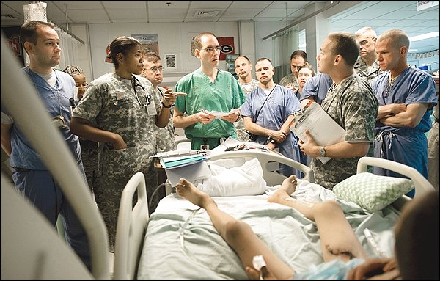
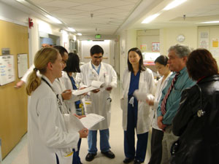
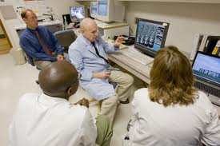
Conclusion
Areas not covered:
Pediatrics
Gerontology
Alternative medicine
Psychiatry

